Slide 1
Physics 201
Winter 2013
Simple collisions

Slide 2
Momentum = motion?
Winter 2013
Imagine objects of equal mass that collide with equal but opposite momentum and stick together
What happens? They stop because the incoming momenta are equal and opposite
Consider the opposite scenario: an explosion – the net momentum of all that shrapnel is zero
Why then do we say that momentum characterizes motion?

Slide 3
Kinetic energy distinguishes these collisions
Winter 2013
In the collision kinetic energy was destroyed; in the explosion kinetic energy is created
This spectrum is characterized by a “coefficient of restitution” which records the speed differential before and after the collision
All kinetic energy lost
Kinetic energy unchanged
Kinetic energy created
Completely
inelastic
Perfectly elastic
Explosion
from rest
Objects “stick together”
Objects “bounce”
Objects “explode”

Slide 4
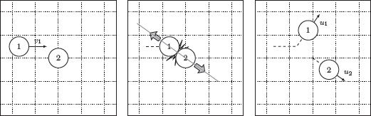
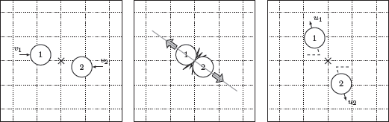
Analysis of collisions requires a frame of reference
Winter 2013
Same collision, two different points of view
“Transforming” coordinates is the process of moving mathe-matically from one frame to another

Slide 5


Center of mass
Winter 2013
The center of mass for a system is a kind of weight-average for its location. Between two particles it is defined as
The speed of the center of mass is unchanged by the collision
This follows because both momentum and mass are conserved in every collision and interaction
Total momentum
Total mass
Show me

Slide 6
Center of mass vs. lab reference frames
Winter 2013
The “center of mass frame” is used when all the velocities are measured relative to the CM
The advantage of the CM frame is that the net momentum is zero by definition – the two particles always have equal and opposite momentum
Another common reference is the “lab frame”: velocities are relative to one of the particles
The velocity of the chosen particle is zero by definition which make the math a bit simpler

Slide 7
Sidebar:
Notation on collisions
Winter 2013
Keeping track of the two particles, before and after the collision, especially in two and three dimension can be a bit of subscript nightmare
One convention is to use the letter “v” to denote the initial velocities and “u” for the final velocities. In this lecture, I will use this convention
So, for example, the conservation of momentum for two particles is

Slide 8
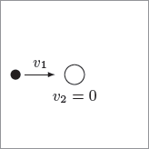
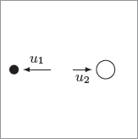



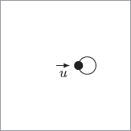

Elastic collisions bounce, completely inelastic stick
Winter 2013
Perfectly Elastic
Completely Inelastic
Show me

Slide 9
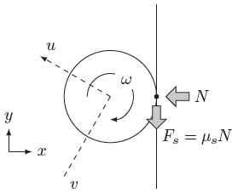
What about angular momentum?
Winter 2013
In a clean collision the ball must “roll” off the surface
This constraint causes a more complex rebound than for a simple particle
In many sports, the spin of the ball into a bounce is a critical strategic element
  E.g., tennis, billiards

